Slide 1


SPOTTHEFAKE: A Fake Product Review Spotter
Enhancing E-commerce Trust
Online shopping is plagued by fake reviews that mislead consumers and damage the credibility of e-commerce platforms. SPOTTHEFAKE (Veritas) is a cutting-edge system designed to combat this issue by providing a comprehensive, product-level Trust Score.

Slide 2


Introduction: The Pervasive Problem of Opinion Spam
Fake reviews, often referred to as "opinion spam," pose a significant threat to the integrity of digital marketplaces. They not only damage consumer trust in individual products but also undermine the entire e-commerce ecosystem.
SPOTTHEFAKE aims to solve this critical problem by acting as an AI-powered "detective." We automatically flag fraudulent reviews and consolidate this analysis into a definitive and easily interpretable product Trust Score.
Trust Erosion
Fake reviews confuse consumers, leading to poor purchasing decisions and increasing product return rates.
Detection Challenge
Spammers continuously evolve their tactics, requiring dynamic, machine-learning based detection models.

Slide 3



Method: A Hybrid Approach to Feature Engineering and Modeling
Our detection methodology follows a rigorous three-step process, focusing on collecting comprehensive data, engineering fraud-revealing features, and implementing a powerful hybrid classification model.
Step 1: Data Acquisition & Preprocessing
Step 2: Advanced Feature Extraction
Step 3: Hybrid Classifier Implementation
Collect raw data: review text, star ratings, reviewer IDs, timestamps, and crucial metadata like 'verified purchase' status. Preprocess text data (tokenization, lemmatization, stop word removal) to ensure model accuracy.
Engineer features across three critical dimensions: Text, Behavior, and Temporal patterns, to create a multi-faceted profile for each review and reviewer.
Develop a powerful hybrid model combining the strengths of specialized techniques to maximize fraud detection precision and recall.

Slide 4
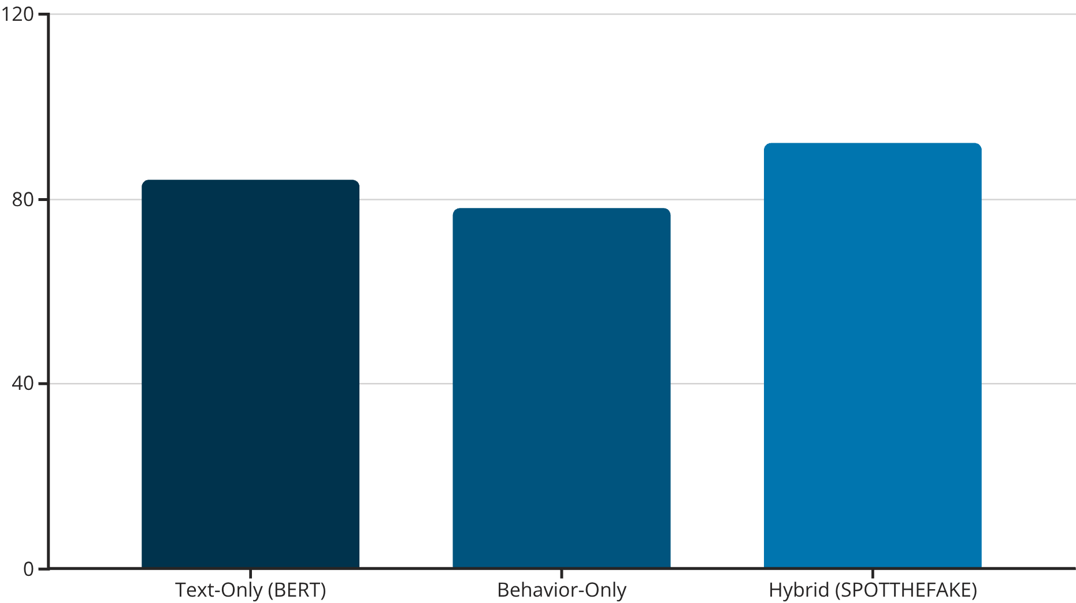
Performance Metrics and Key Results
Testing demonstrates that our multi-faceted, hybrid model significantly outperforms traditional detection methods, especially those reliant solely on textual analysis.
Key Findings from Model Evaluation
Hybrid Superiority
Hybrid models consistently outperform text-only approaches, proving that fraud is better detected by analyzing behavior, not just language.
Co-Burst Detection
Temporal "co-burst" features are highly effective in identifying organized, coordinated groups of fake reviewers operating from multiple accounts simultaneously.
User Trust & Explainability
The integration of behavioral and temporal features via the XGBoost component provides crucial context that improves the precision of the Transformer-based text analysis, resulting in a higher overall accuracy score of 92%.
Providing transparent explanations (e.g., "200+ reviews for this product posted within 24 hours") significantly improves user confidence in the Trust Score.

Slide 5


Future Work and Expansion Roadmap
To maintain detection efficacy against evolving spam tactics and expand market reach, our roadmap focuses on three key areas of development.
Global Language Support
Review Image Analysis
Adapt the text analysis component (Transformer models) to support non-English languages, starting with Spanish and German, to expand coverage into international markets.
Implement computer vision models (e.g., CNNs) to analyze attached review images for signs of spam, such as stock photos, irrelevant content, or poor image quality.
The long-term vision is to establish SPOTTHEFAKE as the industry standard for e-commerce integrity, offering a proactive defense against all forms of digital fraud.

Slide 6




Conclusion: SPOTTHEFAKE — AI-Driven Integrity
SPOTTHEFAKE (Veritas) represents a comprehensive and technologically advanced solution to the pervasive problem of fake product reviews. By integrating powerful AI, granular feature engineering, and a focus on transparency, we provide unparalleled protection for shoppers and platforms alike.
AI-Powered Detection
Utilizes a hybrid classification model (Transformer + XGBoost) for maximum accuracy against complex spam.
Actionable Trust Scores
Calculates a reliable product Trust Score, giving shoppers a simple metric for evaluating credibility.
Explainable Results
Offers transparent red flags and explanations directly in the browser extension, building user confidence.
Empowering shoppers to make safer, more informed decisions is our ultimate goal.

Slide 7



Team Members
G.ANUDEEP
SK.ABDUL SABBIR
B.SAGAR REDDY
ID: 2420030148
ID: 2420030151
ID: 2420030157

